Slide 1
CHEM 101 SECTION D
ALIPHATIC HYDROCARBONS

Slide 2
ALIPHATIC HYDROCARBONS
Organic compounds containing only carbon and hydrogen are called hydrocarbons. These are broadly divided into two categories:
(i) Open chain or acyclic hydrocarbons
(ii) Closed chain or cyclic hydrocarbons.
The open chain or acyclic hydrocarbons are also called aliphatic hydrocarbons. These can be further divided into three categories: alkanes, alkenes and alkynes.

Slide 3
ALKANES
Alkanes are saturated acyclic hydrocarbons having the general formula. C_{n}H_{2n+2} where n can be any integer. As such they contain only carbon-carbon and carbon-hydrogen single bonds. Since they are relatively inert towards most of the chemical reagents, they are also called paraffins (Latin: parum = little : affinis = affinity).
In contrast, cyclic compounds corresponding to alkanes or paraffins are called cycloalkanes or cycloparaffins.
Their general formula is C_{n}H_{2n} where n = 3, 4 ... etc.

Slide 4
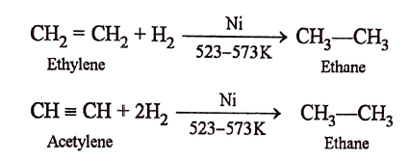
GENERAL METHODS OF FORMATION OF ALKANES
1. Catalytic hydrogenation of unsaturated hydrocarbons: The addition of hydrogen to unsaturated hydrocarbons such as alkenes or alkynes in presence of finely divided metal catalysts such as platinum, palladium or nickel to form alkanes is called hydrogenation.
Note: (i) This hydrogenation of unsaturated hydrocarbons using ordinary nickel at a temperature of about 523-573 K is commonly known as Sabatier and Senderen's reaction or reduction.
(ii). Catalytic hydrogenation is by far the most important method of preparation of alkanes. However, methane cannot be prepared by this method.

Slide 5
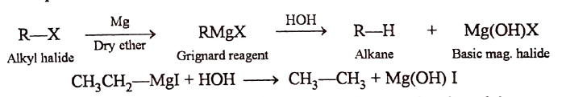
FORMATION OF ALKANES
From Grignard reagents:
Alkyl halides react with magnesium and dry ether to form alkylmagnesium halides called Grignard reagents. These Grignard reagents are very reactive and hence are decomposed by water or any potential proton donor such as alcohols, amines, etc. to form alkanes.

Slide 6

WURTZ REACTION
This method is quite convenient for the preparation of symmetrical alkanes (R-R), i.e., alkanes containing even number of carbon atoms, such as ethane, n-butane, etc. However, it is not suitable for the preparation of unsymmetrical alkanes (R-R'), i.e., alkanes containing odd number of carbon atoms such as propane, n-pentane, etc.

Slide 7
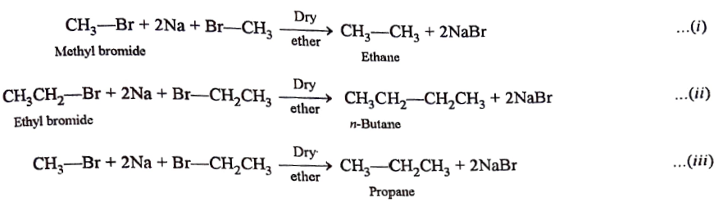
Write note on following wurtz reaction

Slide 8
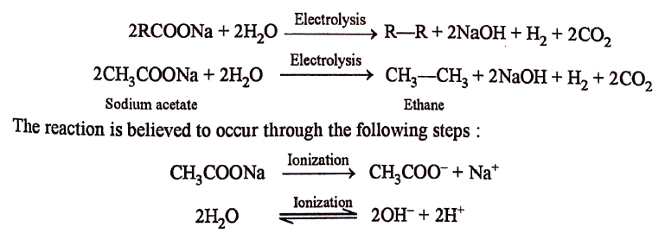
Kolbe's electrolytic method.

Slide 9

REACTION AT CATHODE
As CH₃COO- and OH- ions can migrate towards the cathode, but electron releasing tendency of CH₃COO-ions is much higher so will be discharged in preference to OH- ions.

Slide 10

At anode
Here also Na⁺ and H⁺ ions can migrate towards the anode, but electron accepting tendency of H⁺ ions is much higher than that of Na+ ions, therefore, H⁺ ions will be discharged in preference to Na⁺.

Slide 11
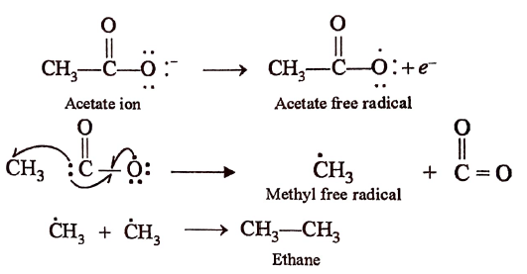
COMPLETE MECHANISM OF KOLBE’S RXN

